Slide 1
Got Mandates?
How Health Courses are Addressing State Mandates
Let’s work together!!

Slide 2
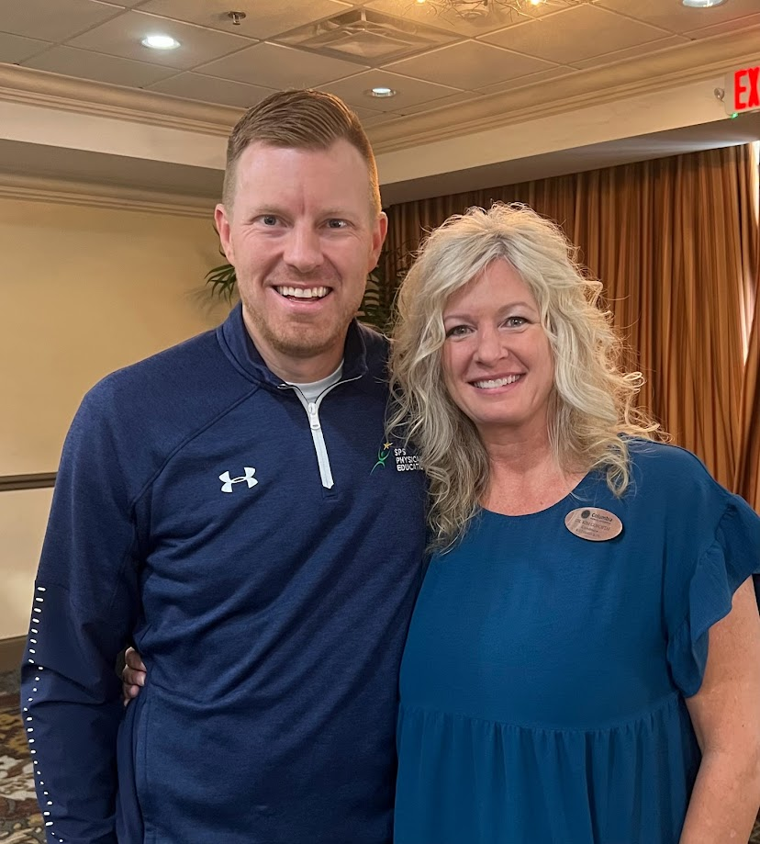
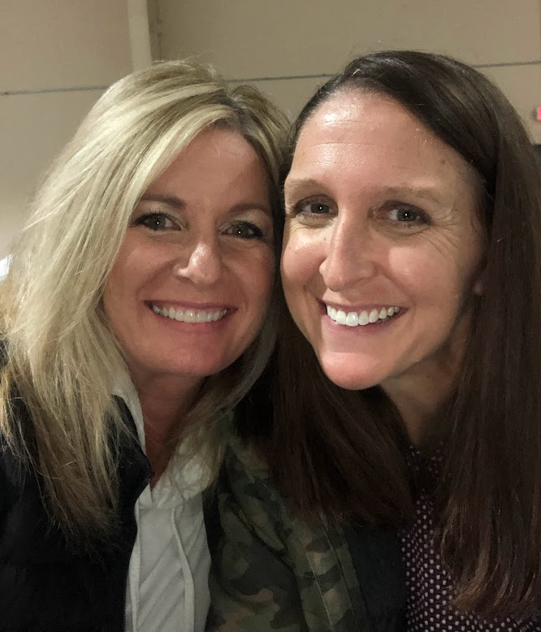
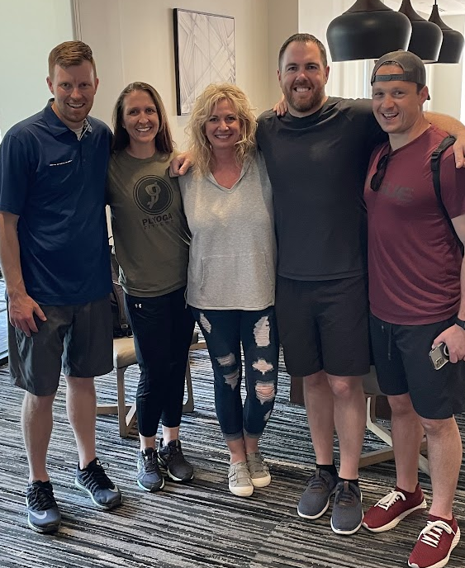
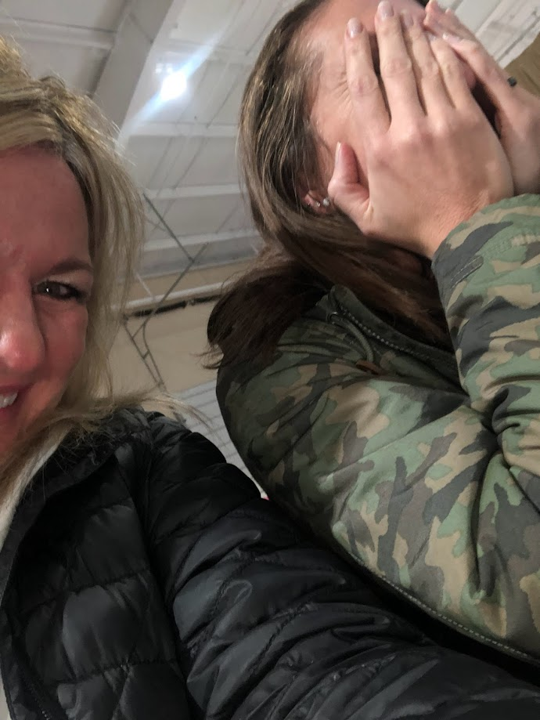
The Fam
February 22, 2024
Dr. Kim Goforth
Columbia Public Schools
kgoforth@cpsk12.org
Dr. Sally Schulte
Rockwood School District
schultesally@rsdmo.org
Mr. Brad Brummel
Springfield Public Schools
bjbrummel@spsmail.org
Dr. Eddie Mattison
Parkway School District
emattison@parkwayschools.net

Slide 3
Participants will be able to:
Identify the 5 state mandates related to health education.
Explain what each mandate expects/needs from a school district.
Create a collaborative plan to address mandates.
Unite and conquer.
Our Learning Outcomes
The Gist
Ideas, Tips/Tricks, Tidbits
Pause-Strategies

Slide 4
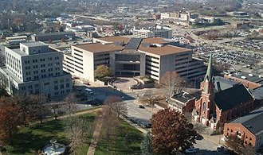
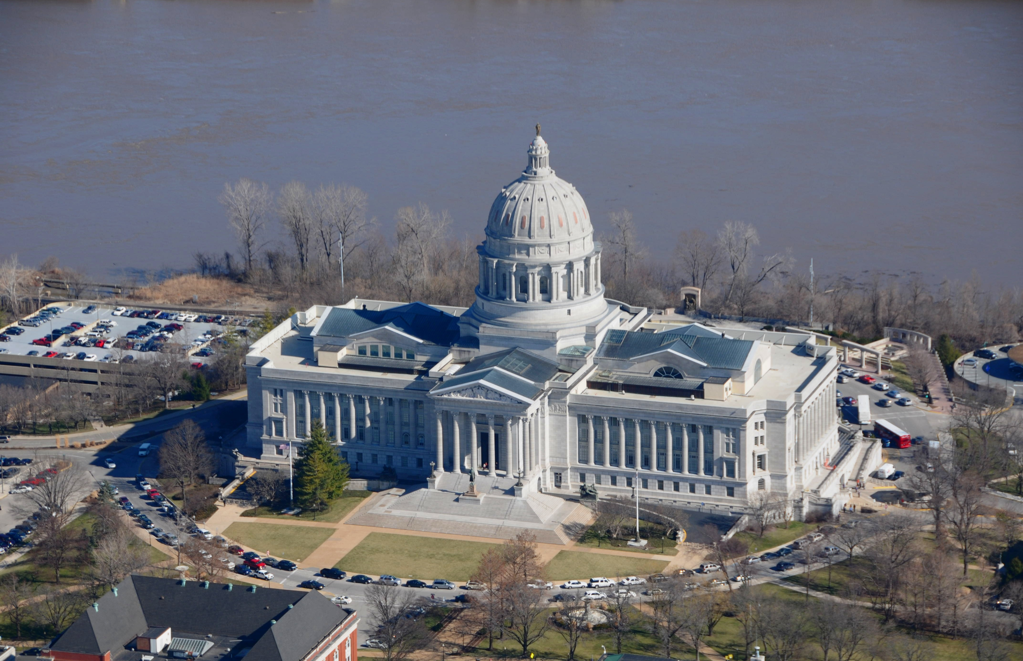
The Big Five
02/22-23/2024
Human Sexuality
CPR/Heimlich
Sexual Abuse Prevention
Mental Health Awareness
Family Health/ Parenting Skills
Accountability (DESE MSIP Assurance Checklist)

Slide 5
The Gist
Date passed: 2015
Medically and factually accurate information
Abstinence preferred behavior
STI’s are legit
Contraception: side effects, benefits, efficiency rates
M/E consequences of sexual activity and/or adolescent pregnancy (include adoption, $, rape)
Social Skills
Sexual predators
HB 501
Human Sexuality Education

Slide 6
The Gist
MAY separate students according to biological/assigned sex
Locally controlled: content
Content is age appropriate
Parent Notification:
Content
Opt-out
CURRICULUM materials available to public
No talk of abortion on materials/ instruction
HB 501
Human Sexuality Education

Slide 7
Ideas, Tips/Tricks, Tidbits
Inclusive Language and Models
Medically accurate language
Understand difference between CURRICULUM and INSTRUCTIONAL MATERIALS
Have a letter; give at least 5 school days for opt-out
Partner with local medical community and health department
Do a parent night
Check all materials (twice)
Check 4th Grade MO GLO’s
Local control
Separating by sex….trends
SB 627–HPV (6th grade)
Sooooooooooo….

Slide 8
Pause
Shoulder Share
Strategy:1(KWL)

Slide 9
The Gist
Date passed: 2016
Started the 2017-18 school year
Before graduation, students in public and charter schools will receive:
30 minutes of Cardiopulmonary Resuscitation (CPR) instruction
Training in the proper performance of the Heimlich Maneuver or other first aid for choking
Included in health or physical education curriculum.
SB 711
CPR/Heimlich

Slide 10
The Gist
American Heart Association or the American Red Cross
Current, evidence-based emergency cardiovascular care guidelines and psychomotor skills incorporated
Psychomotor skills: hands-on practicing and skills testing to support cognitive learning
Teacher not required to be certified CPR instructor
If instruction is not designed to result in certification of students.
Districts can partner with local professionals to provide instruction
SB 711
CPR/Heimlich

Slide 11
Ideas, Tips/Tricks, Tidbits
Instruction vs Certification
Hands-On vs Instruction
Push play!
Outside entities
Other affiliations
Online courses considerations
Long term suspensions
Large districts: same, equitable, uniform message of instruction
Partner with health and/or physical education teachers (unified front)
Coming soon (?) other “and other choking protocals/practices”
Sooooooooooo….

Slide 12
Pause
Shoulder Share
Strategy:One Word

Slide 13
The Gist
Date passed: 2011/2020
Task Force-Prevention of sexual abuse of children
Recommendations by Task Force to Governor by Jan. 2012
May adopt and implement policy:
Age-appropriate curriculum
Training for school personnel
Information to families in school handbook (warning signs, assistance, referral, resources)
Counseling services/resources
Emotional & educational support
SB 286
Sexual Abuse

Slide 14
The Gist
Any adopted policy may address without limitation:
Methods for increasing awareness
Warning signs
Action steps for victims to take to obtain assistance and interventions
Counseling options for students affected by sexual abuse
SB 286
Sexual Abuse

Slide 15
Ideas, Tips/Tricks, Tidbits
Child Sexual Abuse Prevention Education: Guidance and Training Materials
Curriculum Framework by grade span
Agencies, organizations, supports, resources
“Truly Agreed To and Finally Passed”
Be a team: nurses, counselors, social workers/behavior specialists, all teachers
“Monthly bulletin boards” 😏
Sooooooooooo….

Slide 16
Pause
Shoulder Share
Strategy:
10 Word Summary

Slide 17
The Gist
Date passed: 2021? 2022?
22-23 School Year and thereafter…
Students receive mental health awareness training w/in their 4 years of high school
IDEA-students may participate appropriately
Instruction included in health or PE curriculum
Two (2) hours of MH Awareness training (including SEL standards-no longer)
SB 1057
Mental Health Awareness

Slide 18
The Gist
Mental Health Awareness Training:
Model Curriculum (Aug ‘23)
Learning Objectives for K-12
Aligned with NHES and HECAT HBO’s
Defines MH
Strategies for Achieving and Maintaining Sound MH
Decrease Stigma
How to connect to services
SB 1057
Mental Health Awareness

Slide 19
Ideas, Tips/Tricks, Tidbits
Beyond Second Steps
K-12 Considerations
Amendments, new sections, etc.
“Truly Agreed To and Finally Passed”
Inclusive language, bullying, reducing stigma, etc.
Be a team: nurses, counselors, social workers/behavior specialists, all teachers
Sooooooooooo….

Slide 20
Pause
Shoulder Share
Still circling/questions
Key point
Squares w/your thoughts
Strategy:

Slide 21
The Gist
Date passed: 2023
No idea. 😂 A whirlwind
Change name of course
FACS and Health Teachers
Add parenting standards to 9-12 health course
Outcome:
New course standards 9-12
Based on new NHES, HECAT HBO’s, YRBS data, etc.
Encompasses all other mandates
HB 447 (1-3)
Health and Family Education

Slide 22
HB447
Family/Parenting
Analyze expectations and responsibilities of parenting. 15.1.2
Analyze nurturing practices that support human growth and development. 15.2.1
Demonstrate effective communication strategies to prevent, manage, or resolve interpersonal conflicts. 15.2.2
FACS Standards:

Slide 23
HB447
Family/Parenting
4. Assess common practices and emerging research about influences of discipline on human growth and development. 15.2.3
5. Analyze community resources and services available to families. 15.3.1
6. Analyze community resources that provide opportunities related to parenting. 15.3.2
FACS Standards:

Slide 24
HB447
Family/Parenting
7. Analyze biological processes related to prenatal development, birth, and health of child and mother. 15.4.1
8. Analyze social, emotional, and environmental factors of prenatal development and birth in relation to the health of parents and child. 15.4.2
FACS Standards:

Slide 25
Ideas, Tips/Tricks, Tidbits
Presenting work to State Board in April
Repeals currently in progress
Sit tight?
Counselors: scheduling and coding
Next year title change
Didn’t happen for us
Educating districts
Professional development for teachers
Sooooooooooo….

Slide 26
Pause
Shoulder Share
Strategy:
1 Pro–1 No

Slide 27
Working Smarter…
Not Harder.
Identify who is doing what.
Use/Create a District Wellness Committee
Use SHI Data
Talk to Administrators about our place on the DAC

Slide 28
Working Smarter…
Not Harder.
Take copies of bills.
Connect.
What else?
Other ideas?

Slide 29
Thank You!
Presentation

